Slide 1

Agile Software Development
Software Engineering
(BCSC 0009)
Lecture No: 6
Ruchi Agrawal
Assistant Professor, GLA University, Mathura

Slide 2
Waterfall Model
The Waterfall Model was first Process Model to be introduced.
In a Waterfall model, each phase must be completed before the next phase can begin and there is no overlapping in the phases.
In “The Waterfall” approach, the whole process of software development is divided into separate phases.
The outcome of one phase acts as the input for the next phase sequentially.

Slide 3
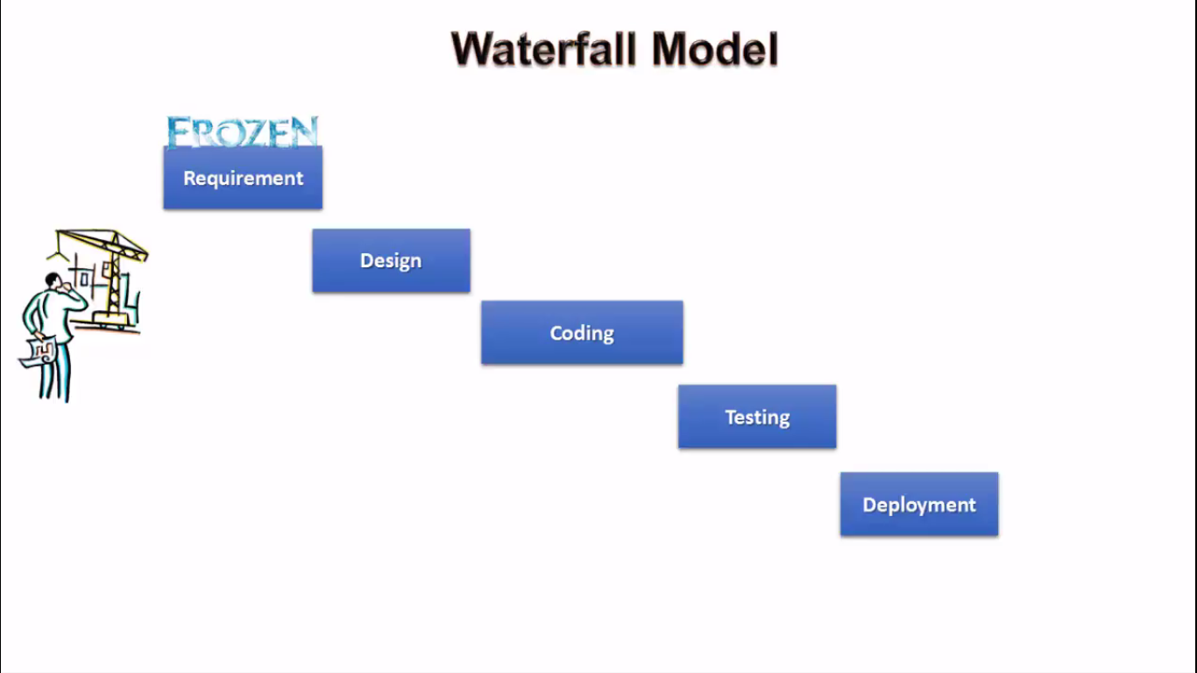

Slide 4
Advantages
It is very simple to understand and use.
Each phase has well defined inputs and outputs.
The client has all of the information about the cost, size, and timeline of the project.
The development team also have an exact idea about the end result of the program and work toward it from the beginning.

Slide 5
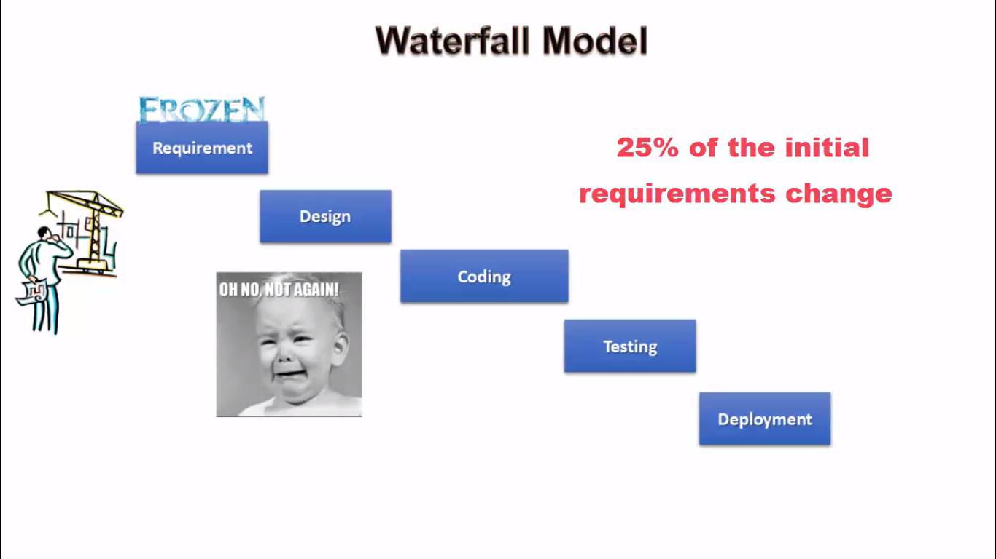

Slide 6
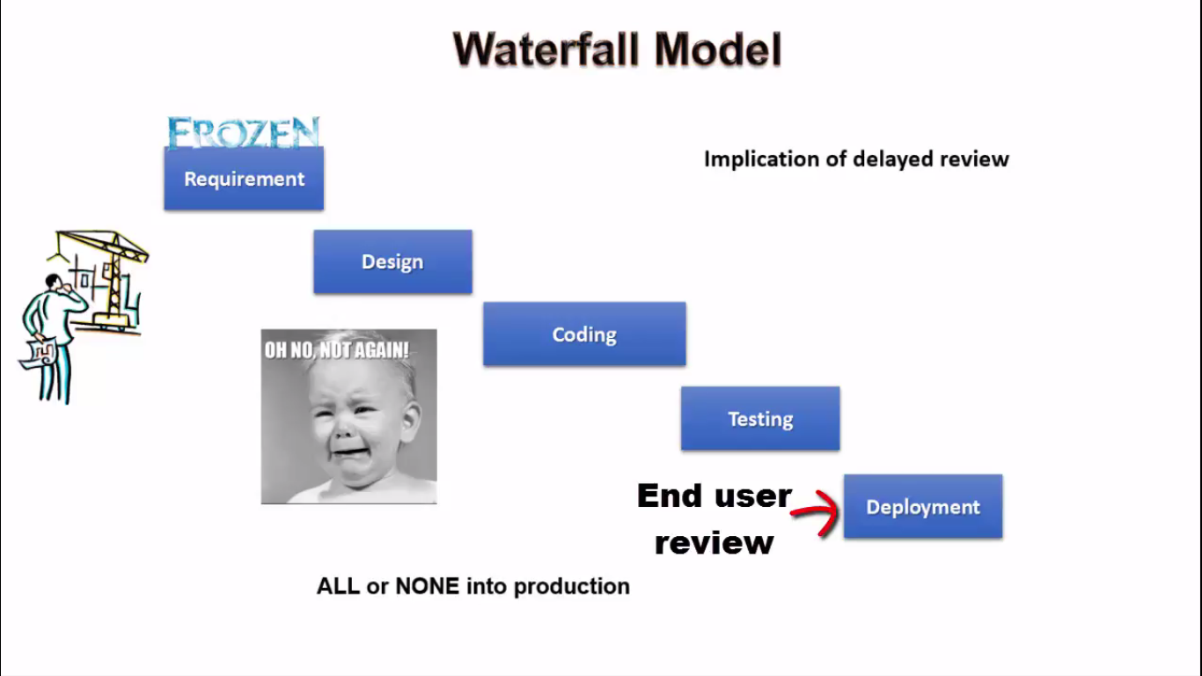

Slide 7
Disadvantages
This model is just like a one-way street. Once the phase X is completed and the next phase Y has started, then there is no provision of going back.
This Model is not suitable to accommodate any type of changes in between the development process.
Users have little interaction with the project team. Their feedback is not taken during development.
After the development process starts changes can not be accommodated easily.
Model do not support delivery of software in pieces.
Not suitable for new projects because of uncertainty in the specification.
Customers gets opportunity to review the product very late.

Slide 8
Industry Moving from Traditional models to Agile Software development model…..
Why?

Slide 9
Agile Software Development
Meaning of agile is active or quick.
Someone who is agile can move quickly, think quickly.
Agile is not a playbook. It’s not a set of directions. It’s not a checklist. As Scott Barber, Chief Technologist, President and CEO said, “It’s a mindset and a culture – and it needs buy-in across an entire organization in order to succeed.”

Slide 10
What is Agile
AGILE methodology is a practice that promotes continuous iteration of development and testing throughout the software development lifecycle of the project. Both development and testing activities are concurrent unlike the Waterfall model.
Agile software development is an approach to software development under which requirements and solutions evolve through the collaborative effort of self-organizing and cross-functional teams and their customer(s)/end user(s).

Slide 11
Who Developed Agile Model?

Slide 12
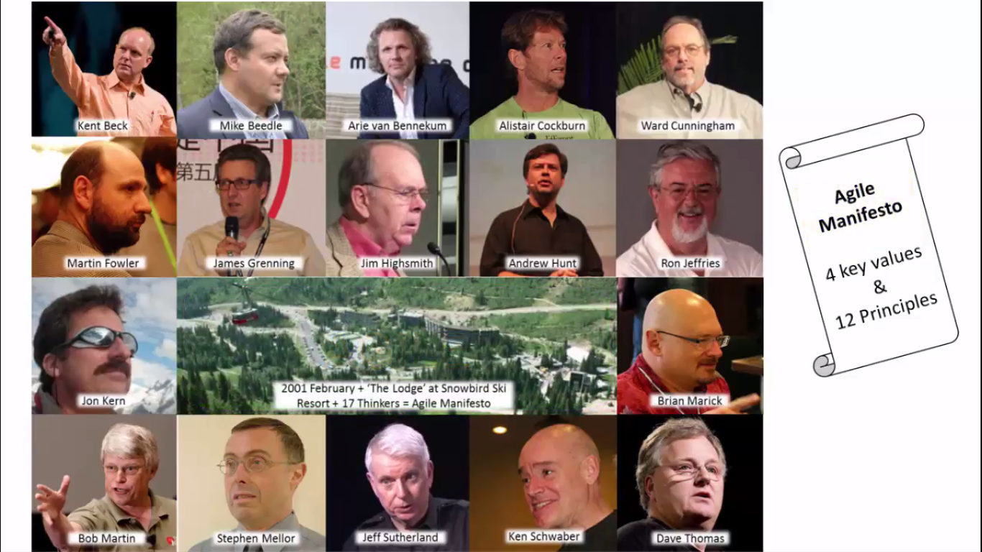

Slide 13
Manifesto for Agile Software Development
We are uncovering better ways of developing software by doing it and helping others do it.
Through this work we have come to value: (4 Key values):
1. Individuals and interactions over processes and tools
2. Working software over comprehensive documentation
3. Customer collaboration over contract negotiation
4. Responding to change over following a plan
That is, while there is value in the items on
the right, we value the items on the left more.

Slide 14
12 Principles behind the Agile Manifesto
Our highest priority is to satisfy the customer through early and continuous delivery of valuable software.
Welcome changing requirements, even late in development. Agile processes harness change for the customer's competitive advantage.
Deliver working software frequently, from a couple of weeks to a couple of months, with a preference to the shorter timescale.
Business people and developers must work together daily throughout the project.

Slide 15
Build projects around motivated individuals. Give them the environment and support they need, and trust them to get the job done.
The most efficient and effective method of conveying information to and within a development team is face-to-face conversation.
Working software is the primary measure of progress.
Agile processes promote sustainable development. The sponsors, developers, and users should be able to maintain a constant pace indefinitely.

Slide 16
Continuous attention to technical excellence and good design enhances agility.
Simplicity--the art of maximizing the amount of work not done--is essential.
The best architectures, requirements, and designs emerge from self-organizing teams.
At regular intervals, the team reflects on how to become more effective, then tunes and adjusts its behavior accordingly.

Slide 17
Why Industry is moving towards Agile
Agile model can easily adopt the changes.
Regular adaptation to changing circumstances.
Even late changes in requirements are welcomed.
Customer satisfaction by rapid, continuous delivery of useful software.
Working software is delivered frequently (weeks rather than months).
People and interactions are emphasized. Customers, developers and testers constantly interact with each other.
Face-to-face conversation is the best form of communication.
Close, daily cooperation between business people and developers.
Continuous attention to technical excellence and good design.

Slide 18
Agile Scrum Framework

Slide 19
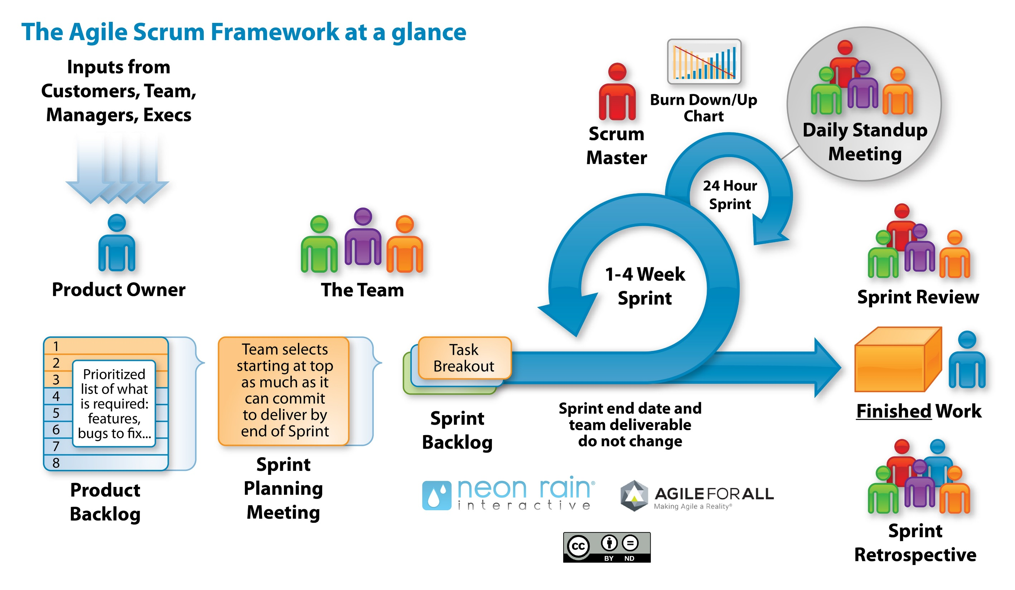

Slide 20
User Story
Format:
As a ……
I need …….
So that ………….
Example:
As a student
I need to make payment
So that I can submit my fees

Slide 21
References
www.agilemanifesto.org
www.mountaingoatsoftware.com

Slide 22


